Slide 1
2016/17 PNF Precipitation

Slide 2
PNF Weather Station Precipitation
March & May: all stations recorded near average precipitation
April & June: all stations recorded below average precipitation
Cherry Average
March: 1.49”
April: 0.72”
May: 0.34”
June: 0.23”
Cherry 2017 (72% of normal)
March: 1.56”
April: 0.08”
May: 0.29”
June: 0.08”
Crown King Average
March: 1.87”
April: 1.16”
May: 0.30”
June: 0.26”
Crown King 2017 (63% of normal)
March: 1.84”
April: 0.09”
May: 0.34”
June: 0.0”
Iron Springs Average
March: 1.60”
April: 0.96”
May: 0.45”
June: 0.37
Iron Springs 2017 (65% of normal)
March: 1.61”
April: 0.31”
May: 0.27”
June: 0.0”
Verde Average
March: 0.76”
April: 0.66”
May: 0.19”
June: 0.11
Verde 2017 (90% of normal)
March: 1.10”
April: 0.02”
May: 0.26”
June: 0.16”

Slide 3
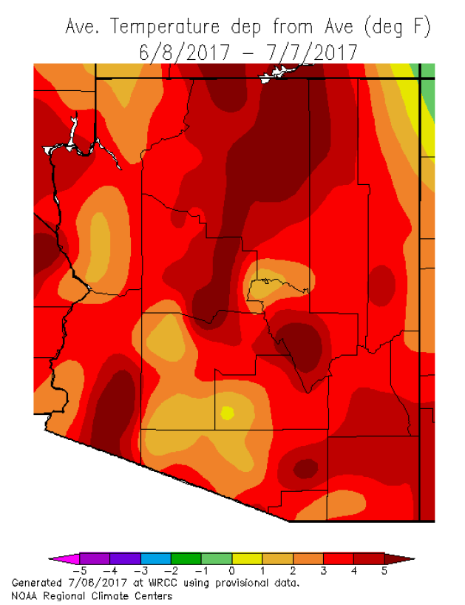
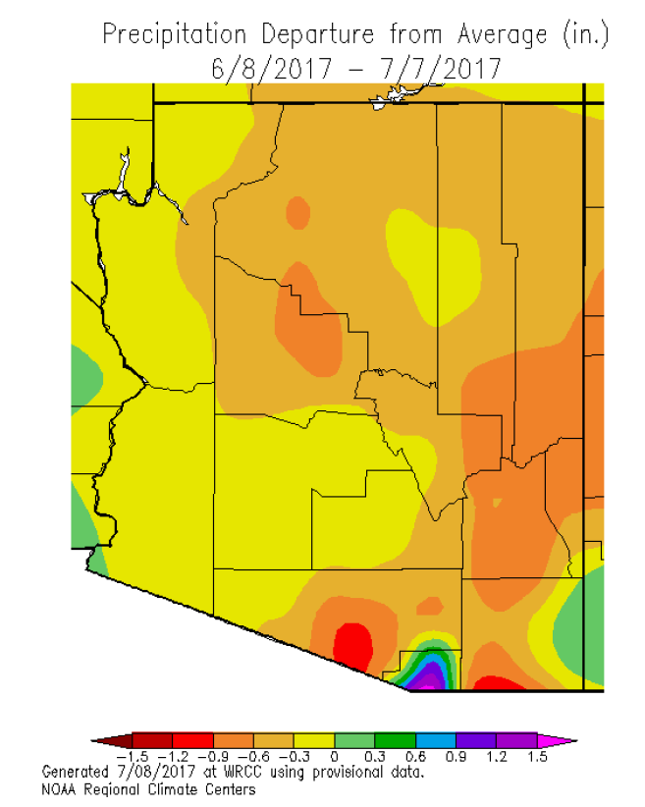
Temperature / Precipitation Last 30 Days Departure from Average

Slide 4
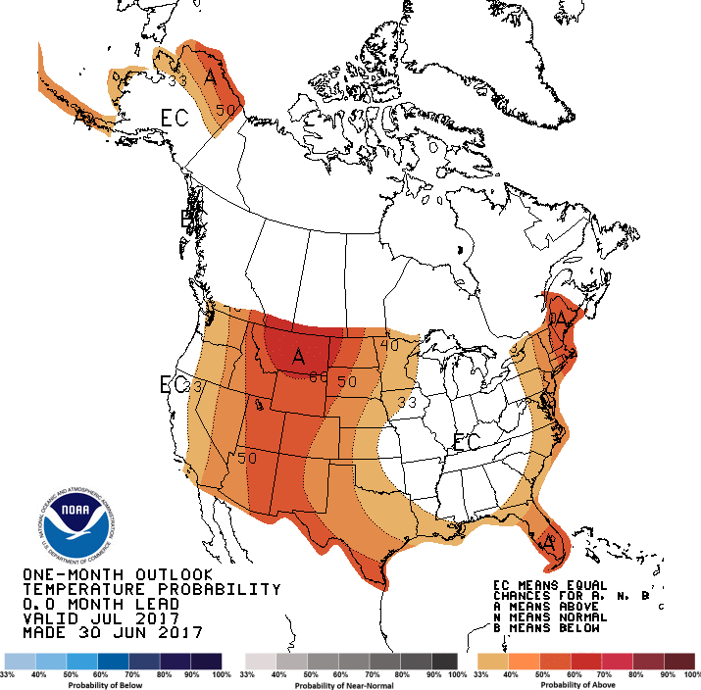
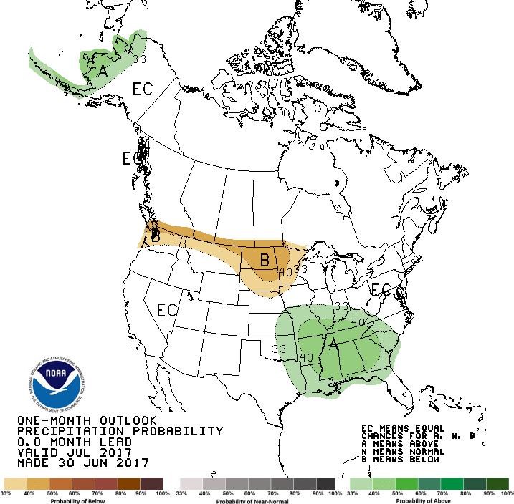
Temperature/Precipitation One-Month Outlook
Above Normal temperature for Arizona. Normal precipitation for Arizona.

Slide 5
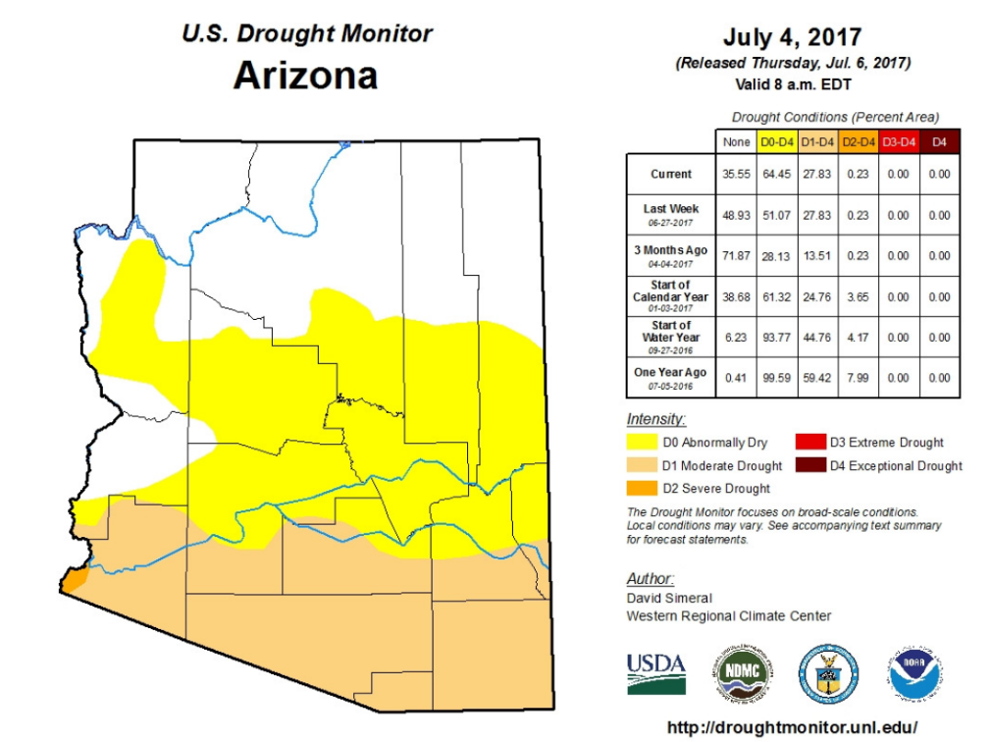
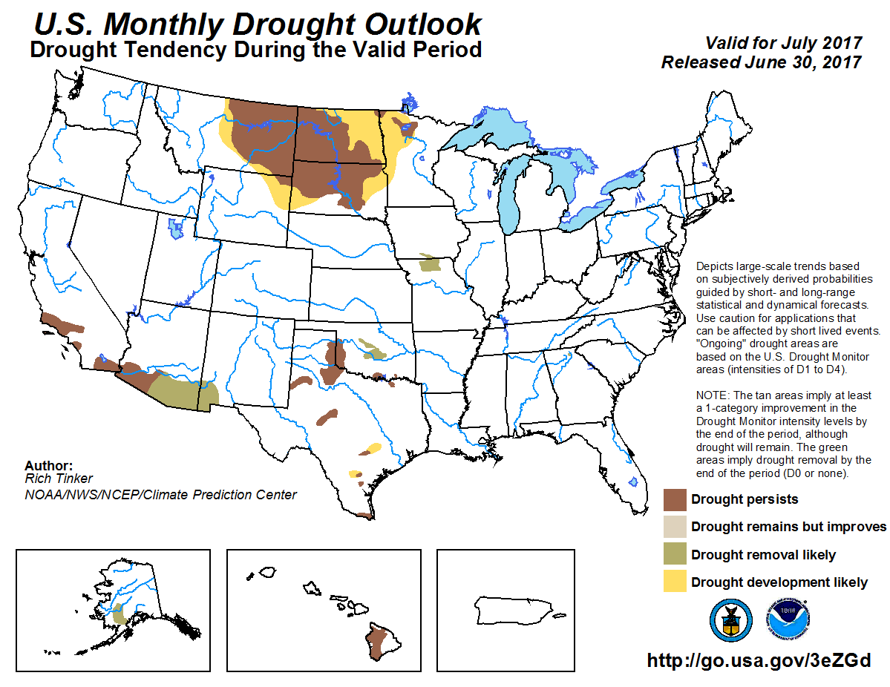
Drought Monitor
Almost all of Yavapai County is experiencing Abnormally Dry conditions

Slide 6
Dead Fuel Moisture
Dead Fuel Moisture is the moisture content of dead organic fuels that is controlled entirely by exposure to environmental conditions. There are four fuel classes modeled within NFDRS.
1-Hour Fuel Moisture - Dead fuels less than ¼” in diameter. Very responsive to current conditions (temperature, humidity, precipitation). Value range: 1 - 80%
10-Hour Fuel Moisture - Dead fuels ranging from ¼” to 1” in diameter. Responsive to daily changes in weather. Value range: 1 - 60%
100-Hour Fuel Moisture - Dead fuels ranging from 1” to 3” in diameter. As opposed to 1 & 10-Hour, these fuels are impacted by 24-hour trends (Max/Min Temp, Max/Min RH, precipitation duration). Value range: 1 - 50%
1000-Hour Fuel Moisture - Dead fuels ranging from 3” to 8” in diameter. Value is based on running 7-day average. Impacted by 24-hour Max/Min Temp, Max/Min RH and precipitation duration values for a 7-day period. Value range: 1 - 40%

Slide 7
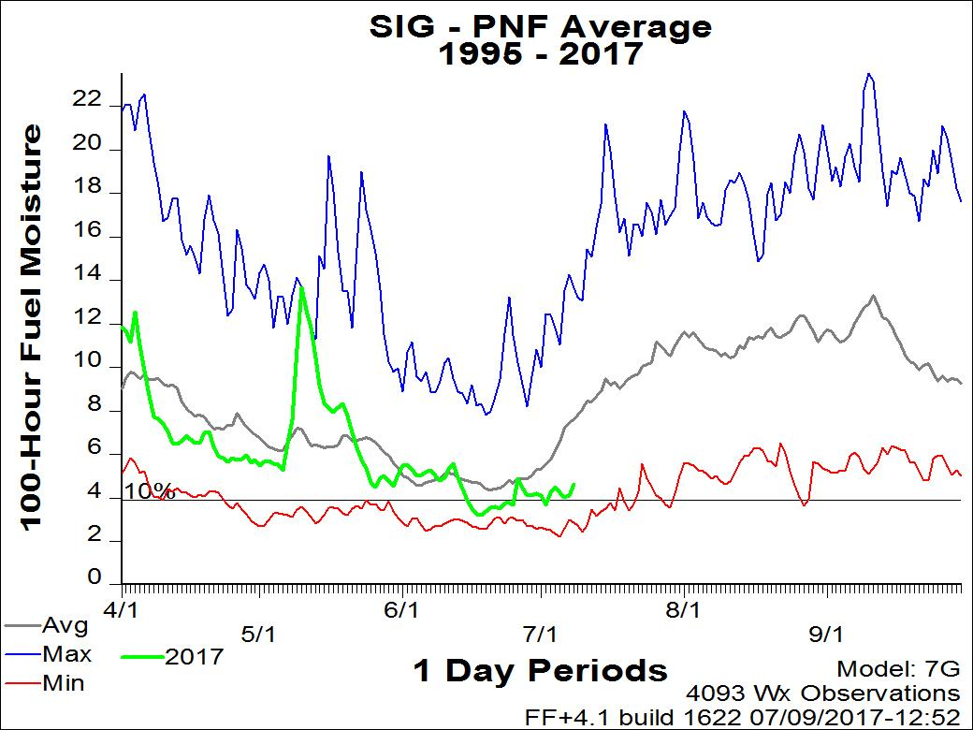
PNF 100-hr Fuel Moisture
The 100-Hour Fuel Moisture values are currently below average but above the 90th Percentile …from 1995-2017, only 10% of the 4,093 days recorded a value below this line

Slide 8
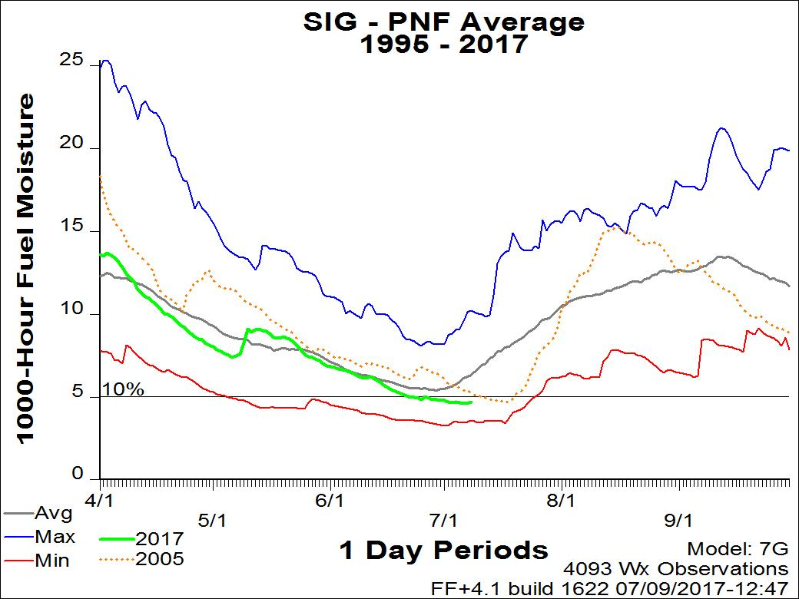
PNF 1000-hr Fuel Moisture
The 1000-HR Fuel Moisture values are below average and near the 90th Percentile
Comparison to 2005
2005 similar to this year’s winter & spring conditions, resulting in heavy fine fuel loading and high fire occurrence in the lower elevations

Slide 9
Energy Release Component
The Energy Release Component is a number related to the available energy within the flaming front at the head of a fire. Daily variations in ERC are due to changes in the moisture content of the fuels present, both live and dead. As live fuels cure and larger dead fuels dry, ERC values get higher.
The 1000-hr Fuel Moisture is one of the primary inputs into the ERC calculation and as such, 24-hour Max/Min Temperature, Max/Min RH and Precipitation Duration all affect the calculation. Since wind and fine fuel moisture do not affect the ERC calculation, the daily variation is relatively small.
The ERC scale is open-ended or unlimited and is heavily dependent on the fuel model that is being used. Historically on the Prescott NF, the highest ERC values in the G fuel model have been around 110, while the highest ERC values in the B fuel model have been around 150.

Slide 10
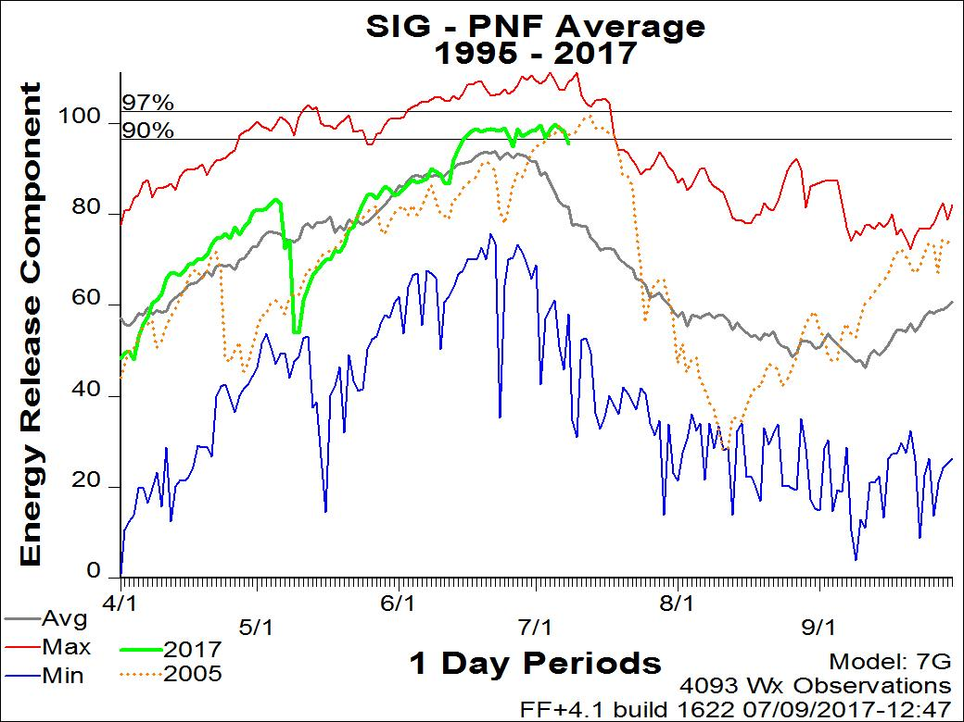
ERC - PNF Average
ERC values are currently above average and near the 90th Percentile …from 1995-2017, only 10% of the 4,093 days recorded a value above this line

Slide 11
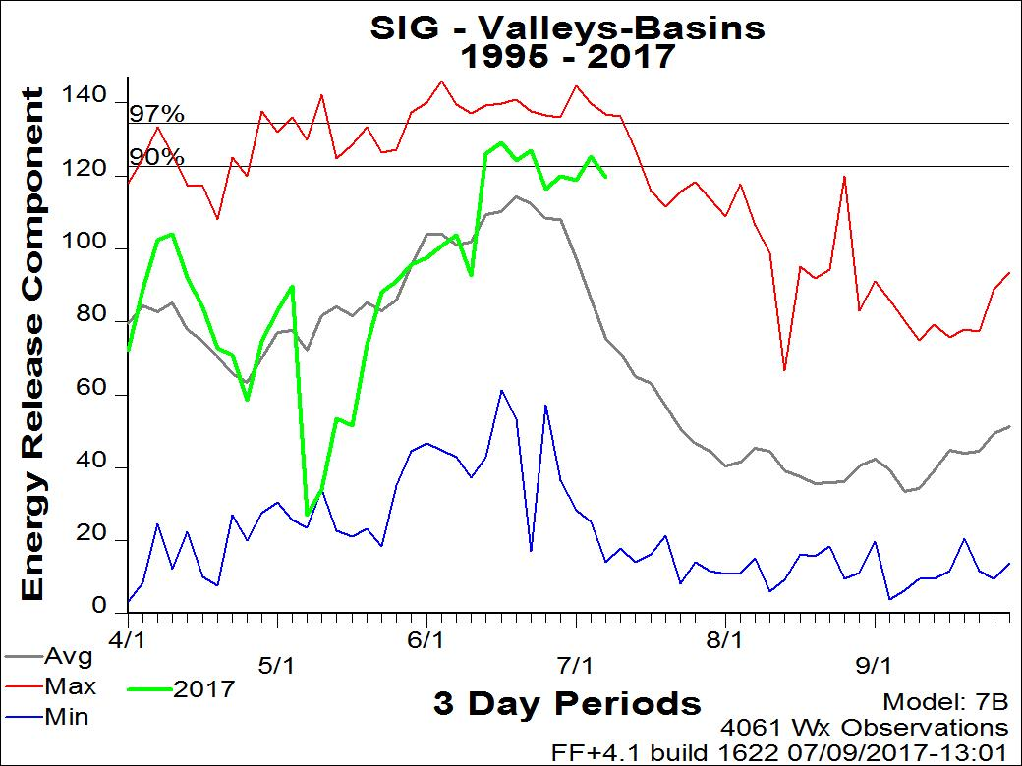
ERC - PNF Valleys & Basins (fuel model b)
ERC values are currently above average and near the 90th Percentile …from 1995-2017, only 10% of the 4,061 days recorded a value above this line

Slide 12
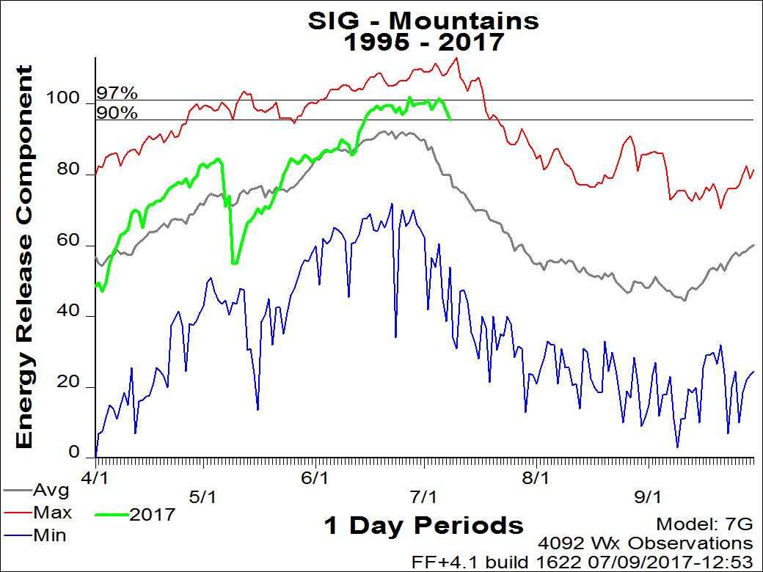
ERC - PNF Mountains (fuel model g)
ERC values are currently above average and near the 90th Percentile …from 1995-2017, only 10% of the 4,092 days recorded a value above this line

Slide 13
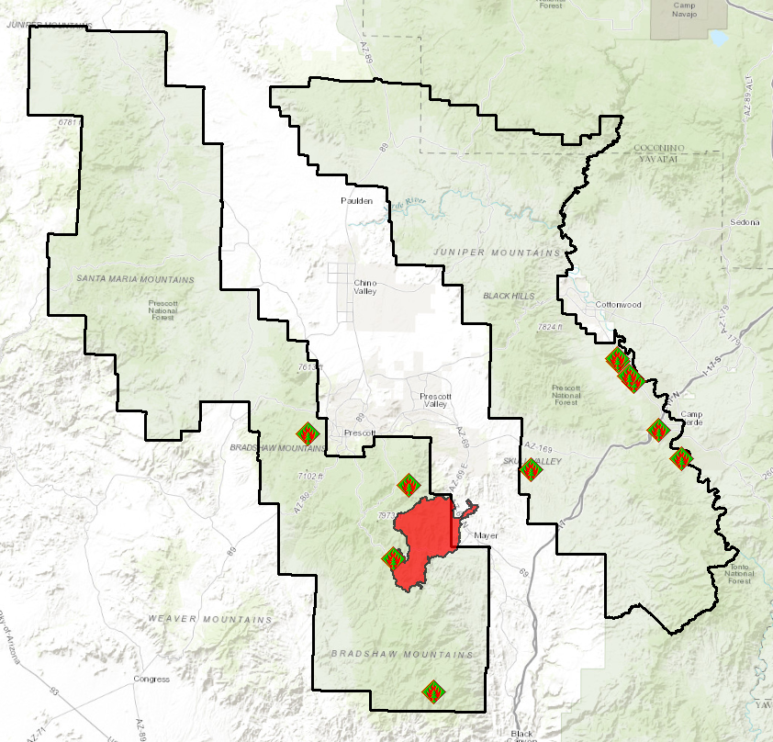
PNF Fire Activity - 2017
Fire Size Class
A: 0 - .25
B: .26 - 9.9
C: 10 - 99
D: 100 - 299
E: 300 - 999
F: 1000 - 4999
G: 5000 +
11 Fires
2 Lightning Caused
9 Human Caused
Fire Size Class: C+
1 Fire – 28,522 Acres
Fire Size Class: A-B
8 Fires - 6 Acres
Fire Size Class: C+
0 Fires - 0 Acres
Fire Size Class: A-B
2 Fires - 0 Acres
False Alarm Response: 43 (6 last week)
Agency Assist: 15 (3 last week)
Campfires since June 1: 16 (1 last week)

Slide 14
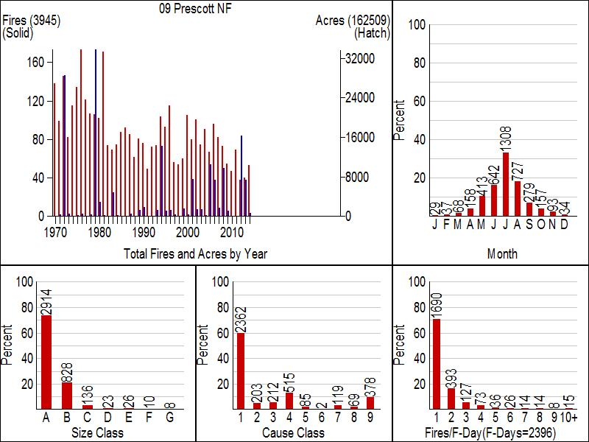
PNF Fire History
Total of 3,945 fires -
Average of 90 fires per year
Total of 162,509 acres –
Average of 3,600 acres per
year
Cause: 2,362 Lightning (60%)
1,583 Human (40%)
Size: 95% of the fires
were under 10 acres
Fire Days: Since 1970, there
have been 2,396 days with
at least 1 fire, for an
average of 53 “fire days” per year. In this same period, there have been 706 days with 2
or more fires, for an average of 16 “multiple fire days” per year.

Slide 15
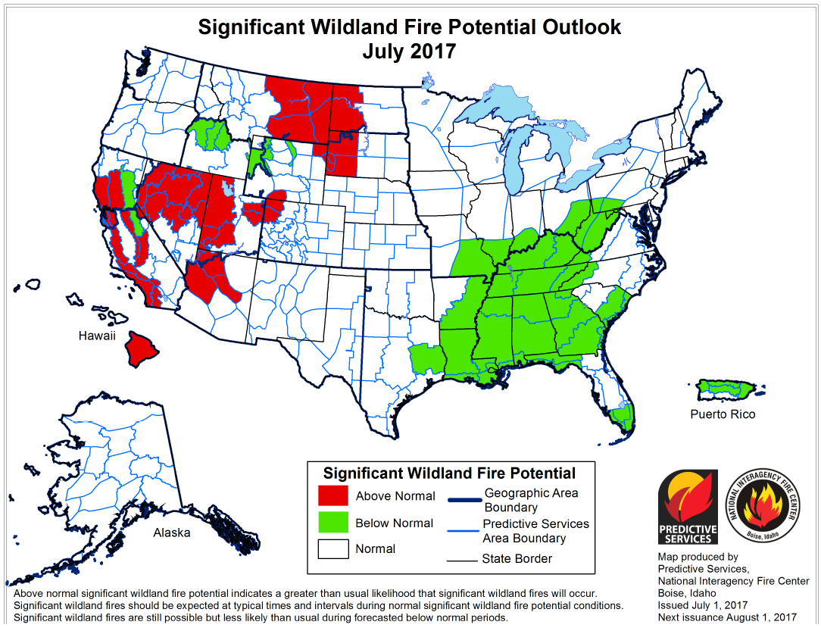
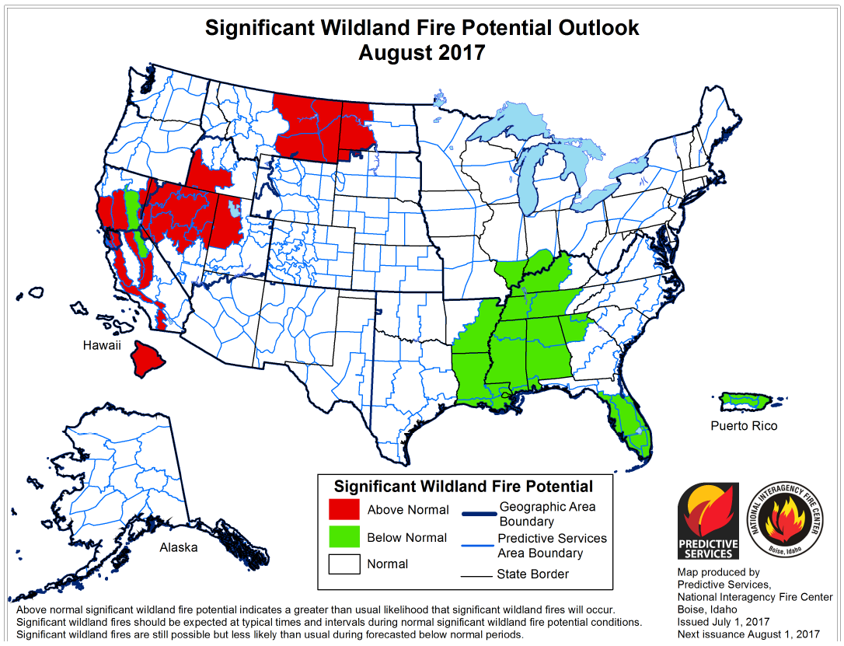
Fire Potential Outlook

